Slide 1
Docker Introduction
Another docker introduction in 2019….

Slide 2
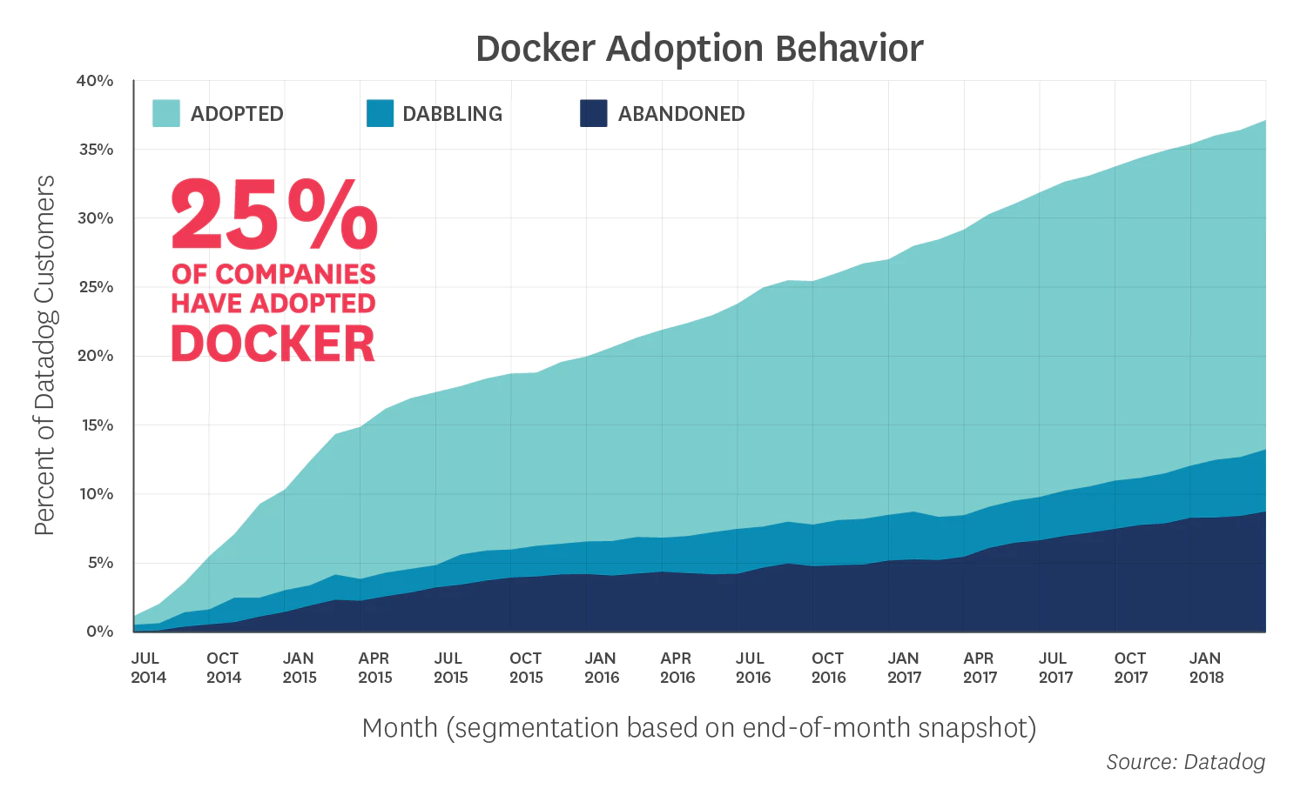
History
dotCloud internal project by Solomón Hykes
dotCloud reinvented itself as Docker in 2013
Docker software open source project was released in 2013
Solomón Hykes left Docker in March, 2018
Nowadays the main docker contributors are: The Docker team, Cisco, Google, Huawei, IBM, Microsoft, and Red Hat

Slide 3
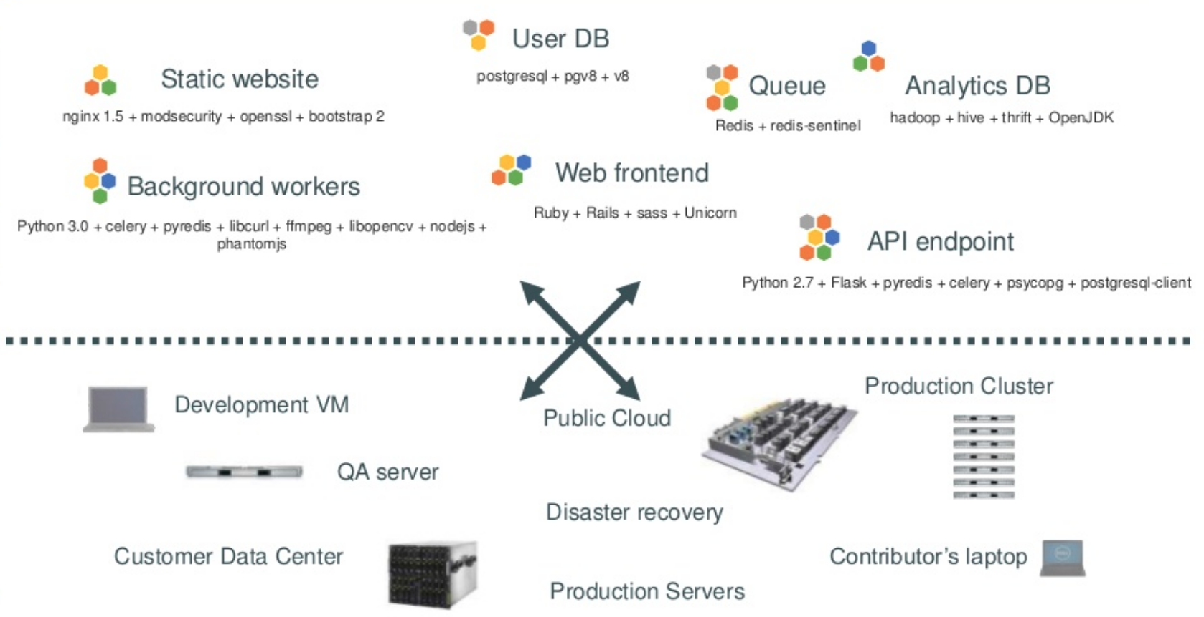
The current (past) challenge

Slide 4
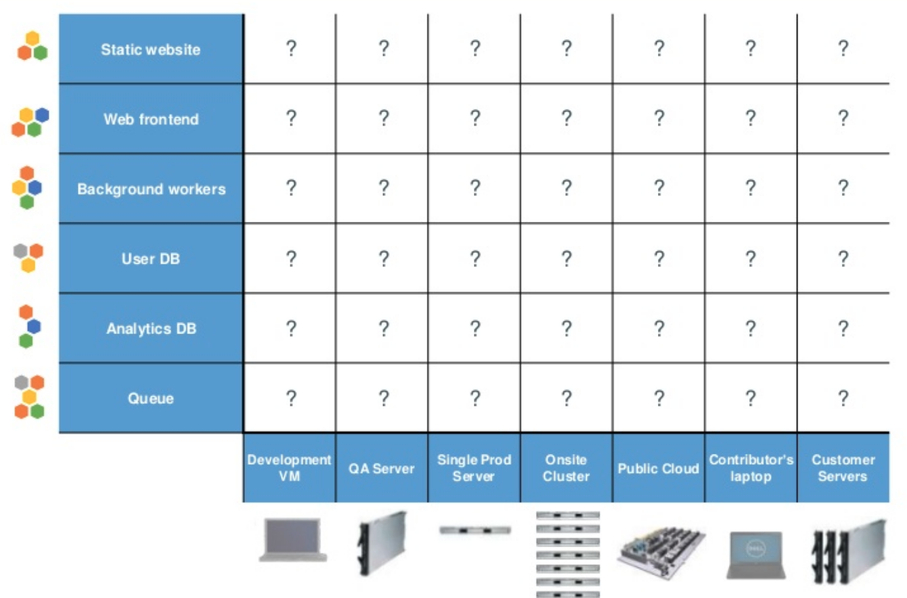
The current (past) challenge

Slide 5
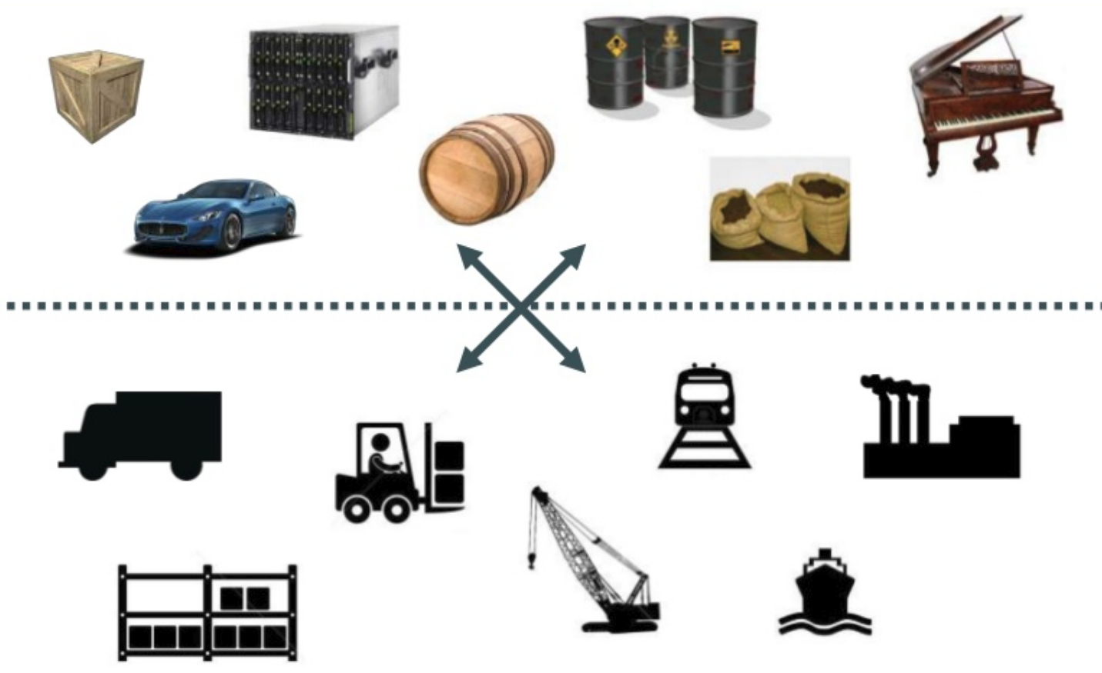
The current (past) challenge

Slide 6
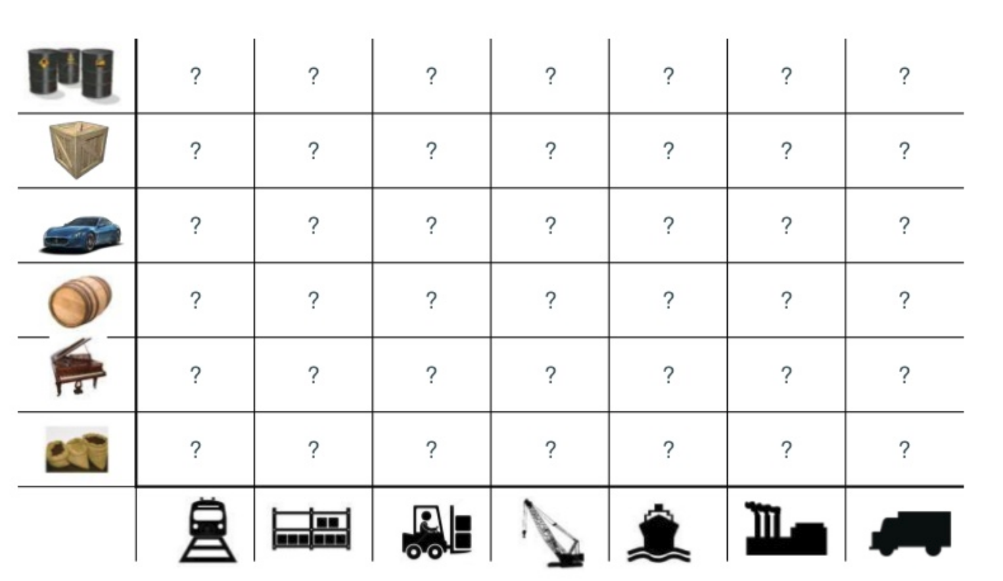
The current (past) challenge

Slide 7
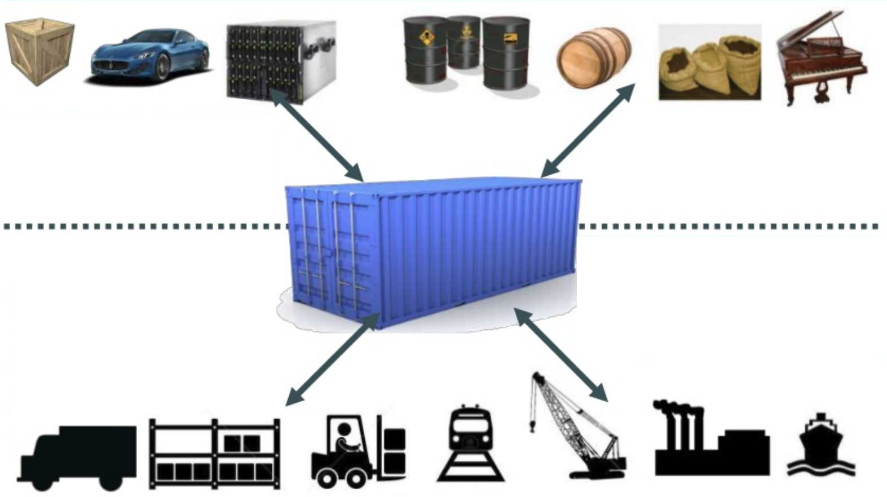
The current (past) challenge
A standard container that is loaded with any goods and stay sealed until the final delivery
… in between, can be loaded, unloaded, stacked, transported, etc… in any kind of transport

Slide 8
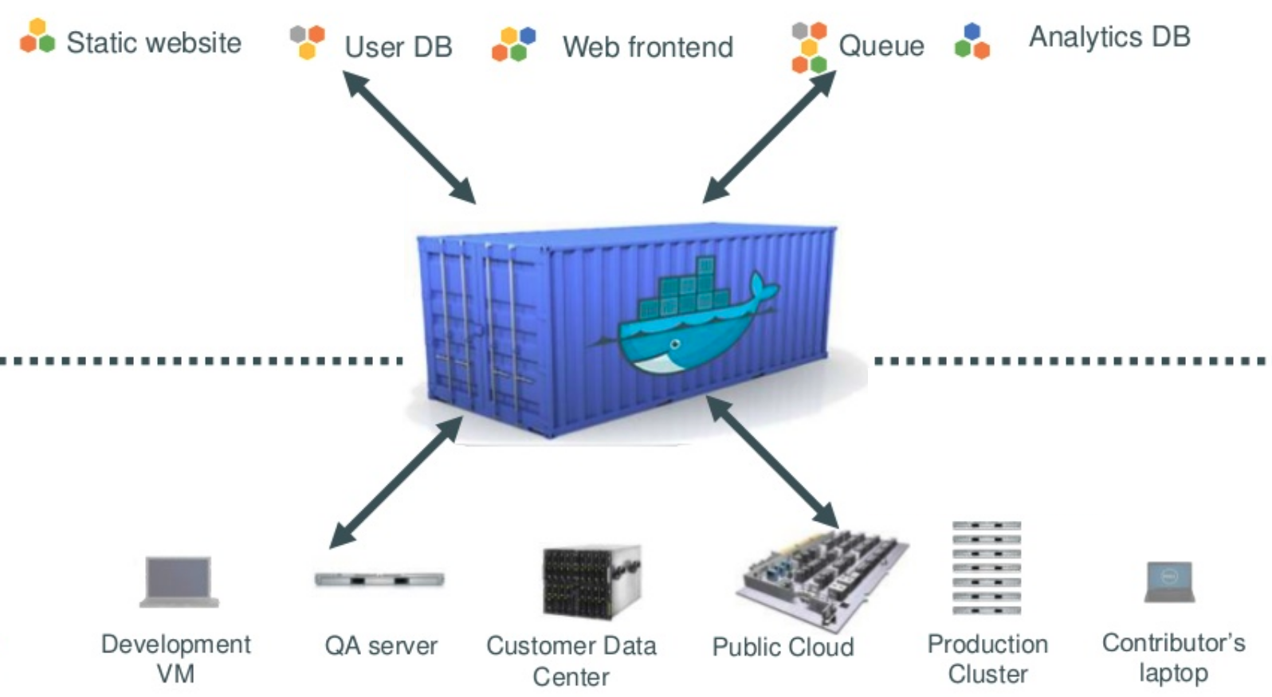
The current (past) challenge
An engine that enables any payload to be encapsulated…
… that can be manipulated using the docker engine to run any container in any hardware platform

Slide 9
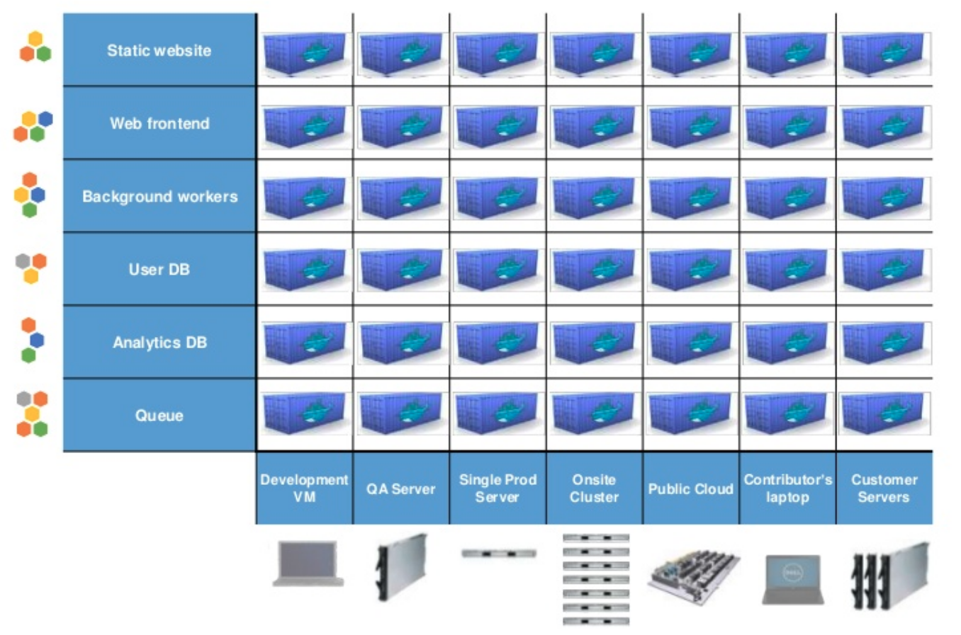
The current (past) challenge

Slide 10
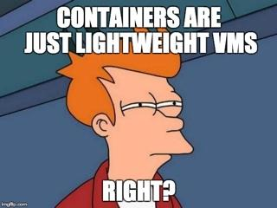


The current (past) challenge

Slide 11
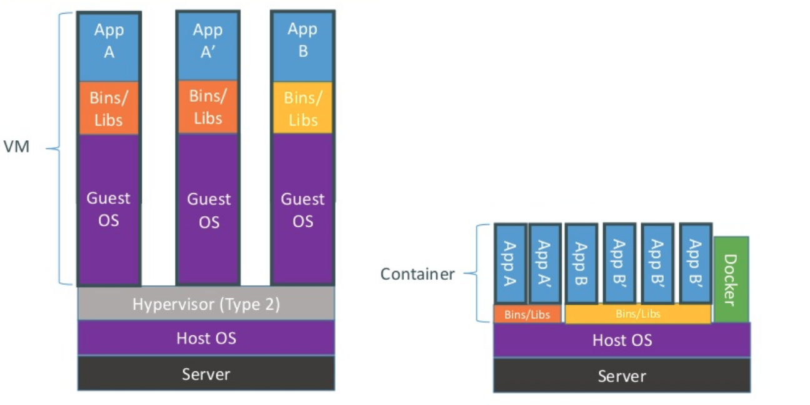
Docker vs VM - An unfair battle
Containers share OS and, where appropriate, bins/libraries. The key: deploying time

Slide 12
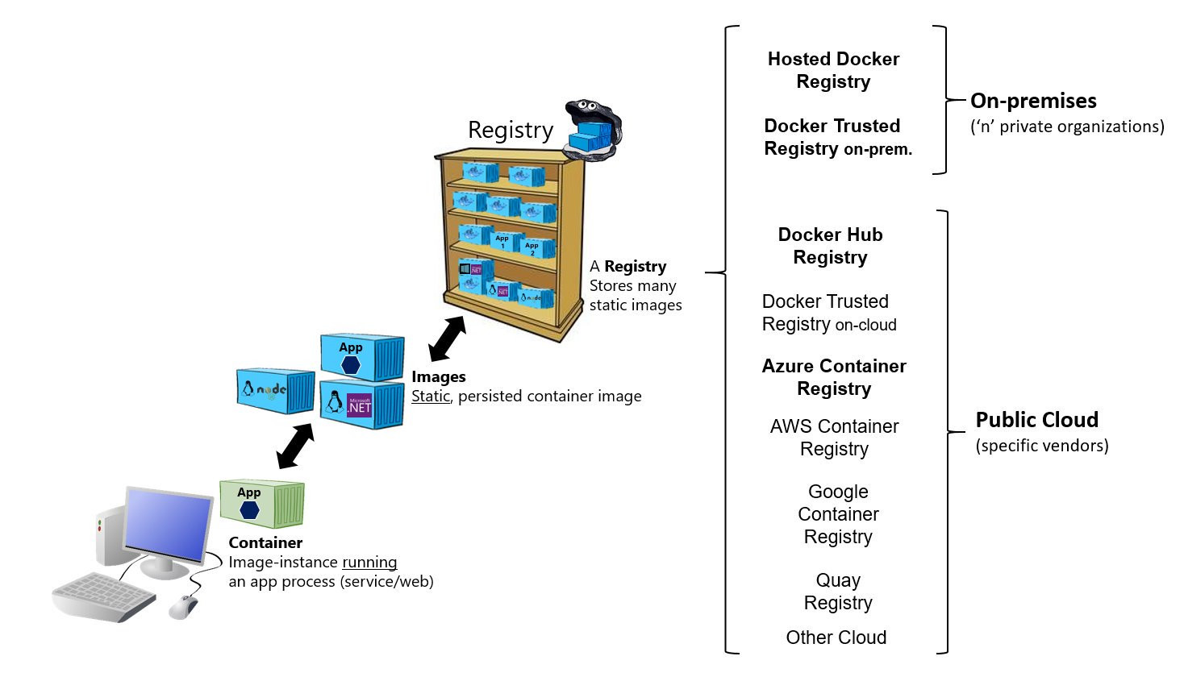
Docker taxonomy

Slide 13
Docker registry
It’s a stateless, highly scalable server side application that stores and lets you distribute Docker images.
Dockerhub https://hub.docker.com
Azure/AWS/GCloud/... Container Registries
Private https://hub.docker.com/_/registry
docker run -d -p 5000:5000 --restart always --name registry registry:2
docker run -d -p 5000:5000 --restart always --name registry registry:2

Slide 14
Docker main commands
run: tries to find the image locally, downloads it if it’s not present, and run it. https://docs.docker.com/engine/reference/run/
search: searches for a coincident image in the registry. https://docs.docker.com/engine/reference/commandline/search/
build: Build an image from a Dockerfile
https://github.com/Ginxo/micronaut-services/blob/master/consul-service/Dockerfile
https://docs.docker.com/engine/reference/commandline/build/
ps: lists containers https://docs.docker.com/engine/reference/commandline/ps/
If no registry is specified, it looks for them in the dockerhub public registry.
docker search <registry_host>:<registry_port>/ngix

Slide 15
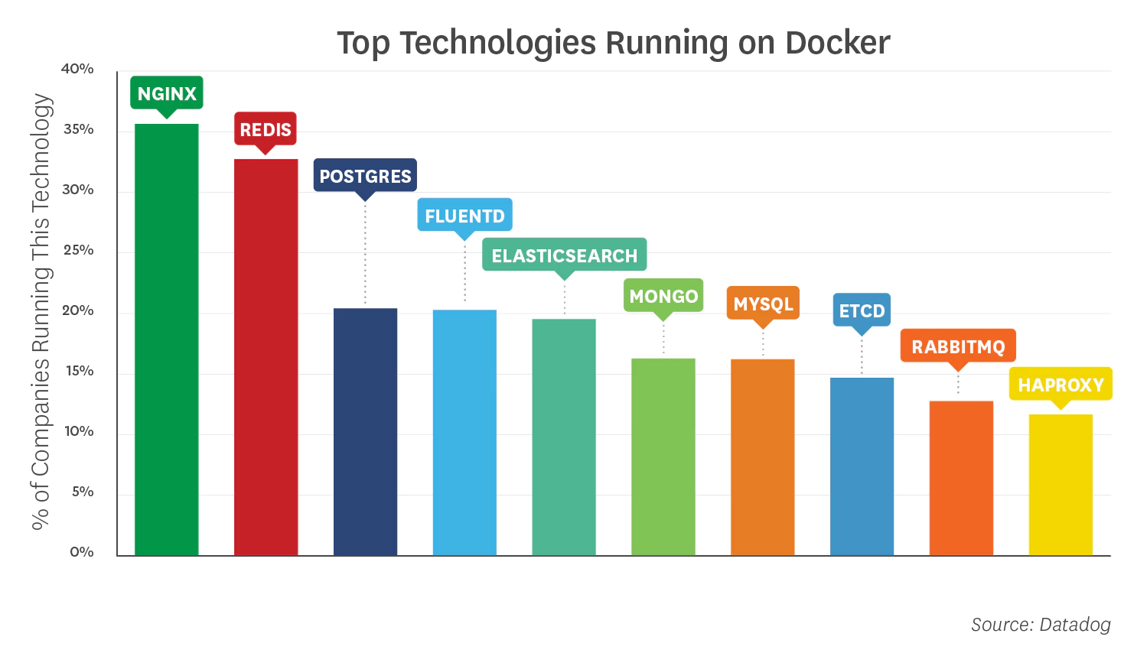
Most Used Docker Images
NGINX: HTTP servers.
Redis: Key-value store which is often used as an in-memory database, message queue, or cache.
Postgres: An open source relational database
Fluentd: An open source data collector for unified logging layer.
Elasticsearch: A distributed datastore and full-text search engine.
MongoDB: TDocument store for a general-purpose NoSQL database.
MySQL: The most popular open source database in the world.
etcd: A distributed key-value store.
RabbitMQ: An open source message broker.
HAProxy: An open source proxy for TCP and HTTP load balancing.
More Images on https://hub.docker.com
Data from 2018

Slide 16
Get your hands dirty...
Hello world example
Apache service
A system to handle the whole docker environment (portainer)
A jenkins + sonar + postgresql + nexus
Maven docker plugin
A web example

Slide 17
Docker compose
Compose is a tool for defining and running multi-container Docker applications
With Compose, you use a YAML file to configure your application’s services
With a single command, you create and start all the services from your configuration
https://docs.docker.com/compose/

Slide 18
Keep the whale happy
The whale feeds on disk
It deletes all the stopped containers, volumes and networks that are not used by containers
docker system prune -a

Slide 19
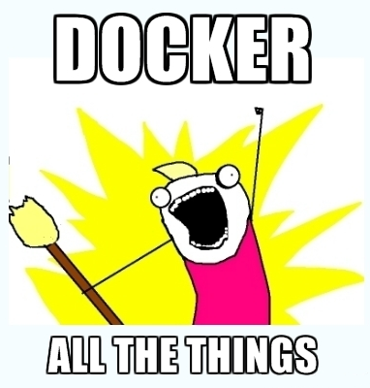
Gracias! preguntas?
Sources:
https://www.docker.com
https://hub.docker.com
https://docs.docker.com
Enrique Mingorance Cano
Center Expert Specialist, HPC Alicante
ginxo
emingora@everis.com

